Slide 1

Environmental Data Analytics
Data-Driven Analysis of
Urban Air Quality
& Traffic Impact
Assessing Environmental Compliance and Health Risks in Indian Cities
Institution
Presented By
MIT Academy of Engineering
Sujal Chaudhari

Slide 2
Presentation Overview
A comprehensive analysis framework linking traffic patterns to urban air quality degradation
Dataset Identification & Relevance
Dashboard Architecture
01
10,000+ environmental records linking traffic density to pollutant concentration
04
Four-pillar visualization: Spatial, Causal, Chemical & Temporal analysis
Theoretical Linkage & Monitoring
Data Visualizations
02
05
Interactive charts showing pollution hotspots, traffic correlation & trends
CPCB framework, NAAQS standards, NCAP & NAMP programs
Environmental Legislation & Compliance
Conclusion & Recommendations
03
06
Air Act 1981, BS-VI norms, EV mission, Non-Attainment Cities
Policy insights: Low Emission Zones & synchronized traffic signals

Slide 3
DATASET OVERVIEW
Dataset Identification & Relevance
Processed Multi-City Air Quality Dataset (2022-2023)
Data Volume & Scope
Contextual Data Layers
Comprehensive environmental monitoring records
Traffic Scenario
Peak vs. Non-Peak hour classification for causal analysis
Total Records
Time Period
Geographic Coordinates
10,000+ entries
2022-23 multi-city
Precise location data for spatial hotspot mapping
AQI Categories
Health impact descriptions aligned with CPCB standards
Key Pollutants Analyzed
Unique Value Proposition
PM₂.₅
PM₁₀
NO₂
SO₂
CO
Fine Particulates
Coarse Particulates
Nitrogen Dioxide
Sulfur Dioxide
Carbon Monoxide
This dataset is unique because it explicitly links traffic density (cause) to pollutant concentration (effect) .
Provides a holistic view of urban environmental health, enabling evidence-based policy interventions.

Slide 4
REGULATORY FRAMEWORK
Theoretical Linkage & Monitoring Bodies
National standards and programs guiding air quality assessment
Central Pollution Control Board
NCAP
Primary Monitoring Authority
National Clean Air Programme
AQI Color Codes: Analysis uses CPCB-defined color-coded health risk brackets (Good → Severe)
PM Reduction Target
20-30%
Standardized Methodology: Consistent calculation protocols across all monitoring stations
Target year: 2024-2025
Health Risk Categories: Direct correlation between AQI values and public health advisories
Dashboard tracks progress toward Particulate Matter reduction goals across monitored cities, providing real-time compliance assessment.
NAAQS Standards
NAMP Framework
All pollutant measurements are compared against National Ambient Air Quality Standards to determine compliance status and identify violations.
National Air Quality Monitoring Programme provides the foundational infrastructure for city-level data collection.
PM₂.₅ Limit
PM₁₀ Limit
Standardized monitoring station protocols
60 µg/m³
100 µg/m³
City-level data aggregation framework
Inter-city comparative analysis capability

Slide 5
LEGAL FRAMEWORK
Environmental Legislation & Compliance
Regulatory mechanisms and emission standards
Air Act 1981
BS-VI Norms
EV Mission
Air (Prevention and Control of Pollution) Act, 1981 provides the legal foundation for air quality management.
Bharat Stage VI Emission Standards represent India's most stringent vehicle emission regulations.
National Electric Mobility Mission promotes transition to cleaner transportation.
Data Justification
Supporting Evidence
Digital Evidence Tool
NO₂ Level Analysis
Peak Hour Pollution Data
Dashboard for GRAP Implementation
GRAP: Graded Response Action Plan
Non-Attainment Cities
The dashboard serves as a digital evidence tool for implementing GRAP, enabling authorities to trigger appropriate response measures based on real-time AQI data.
Cities where AQI consistently breaches the 100-mark (Satisfactory limit) are classified as Non-Attainment Cities requiring prioritized intervention.
Good
Mod
Poor
Sev
Compliance Threshold
AQI ≤ 100
0-50
51-100
101-200
201+
Cities exceeding this limit require action plans

Slide 6
VISUALIZATION STRATEGY
Dashboard Architecture & Objectives
Four-pillar analytical framework for comprehensive environmental assessment
01
Spatial Mapping
02
Causal Linkage
Geographic Distribution Analysis
Traffic Impact Assessment
GIS-based Proportional Symbol Maps visualize pollution concentration across urban geography. Circle size represents pollutant levels; color intensity indicates severity.
Comparative Bar Charts directly contrast pollutant levels during Peak vs. Non-Peak traffic scenarios, quantifying congestion's environmental cost.
Hotspot identification for targeted intervention
Quantify traffic's contribution to pollution
03
Chemical Composition
04
Temporal Trends
Pollutant Source Identification
Time-Series Pattern Analysis
Multi-pollutant breakdown reveals specific industrial vs. vehicular markers. NO₂/CO patterns indicate traffic; SO₂ suggests industrial sources.
Timeline analysis identifies seasonal/monthly breach patterns. Winter months typically show PM spikes; diurnal patterns reveal rush-hour peaks.
Distinguish emission sources by chemical signature
Predict high-risk periods for early warning
Analytical Goal
Transform raw sensor data into Actionable Insights for urban planning and public health warnings. Bridge the gap between environmental monitoring and policy implementation.

Slide 7
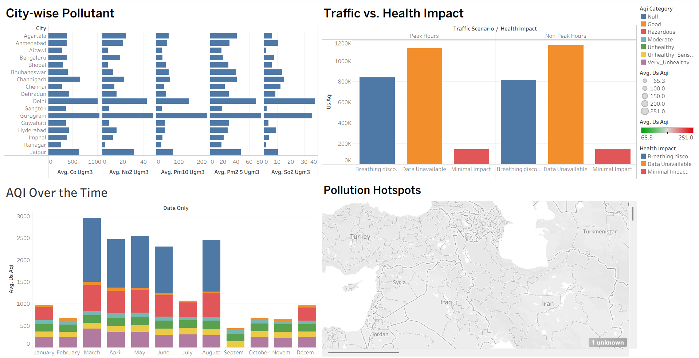

Slide 8
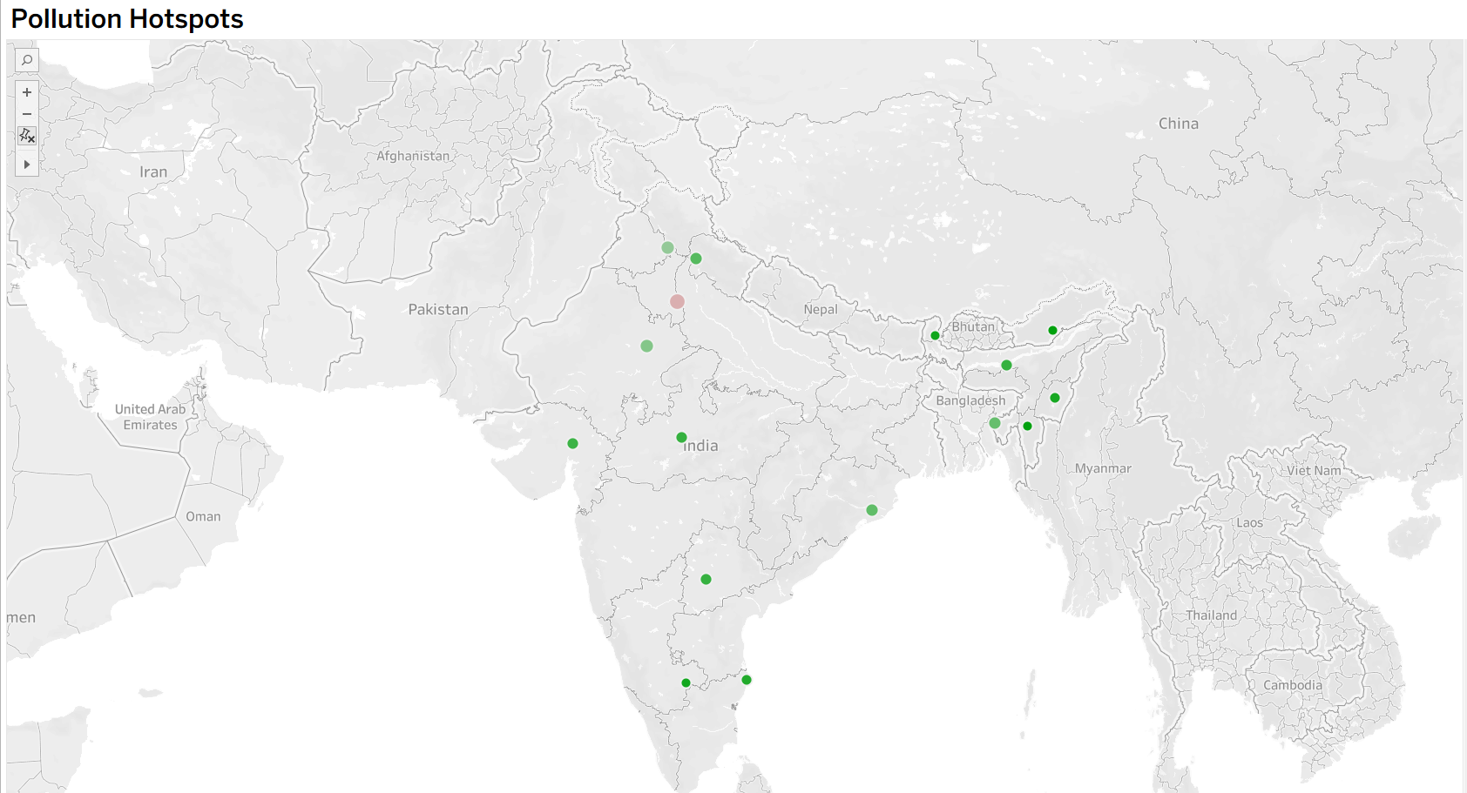
VISUALIZATION 01
Spatial Analysis: Pollution Hotspot Mapping
GIS-based Proportional Symbol Map for geographic distribution analysis
Map Interpretation Guide
Symbol Size
Larger circles indicate higher pollutant concentration at that location
Color Intensity
Darker/warmer colors represent more severe AQI categories
Hotspot Identification
Clusters of large symbols indicate pollution hotspots requiring intervention
Key Insights to Highlight
Major traffic corridors
Industrial zone proximity effects
Residential area exposure levels
City center vs. periphery patterns

Slide 9
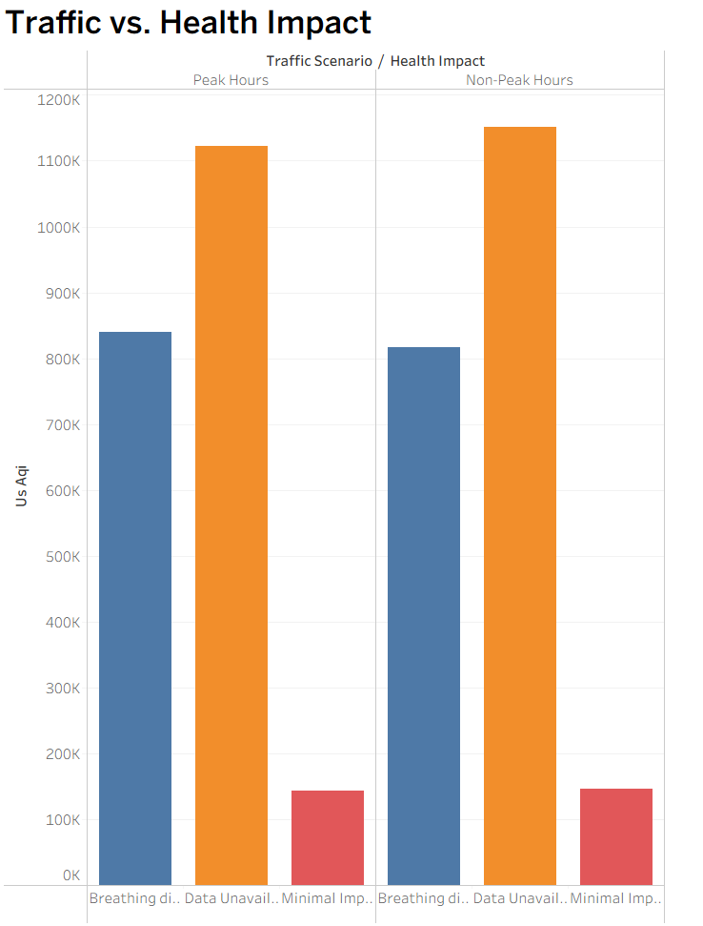

VISUALIZATION 02
Traffic Impact Analysis: Peak vs Non-Peak
Observation: Transitions from "Moderate" to "Poor" categories are frequent during winter months.
Comparative analysis showing congestion's effect on pollutant levels
Chart Interpretation
Peak Hours
Morning (8-10 AM) & Evening (5-8 PM) rush periods
Non-Peak Hours
Mid-day & late-night periods with reduced traffic
Expected Pollutant Patterns
PM₂.₅ & PM₁₀
↑ 40-60%
Significant increase during congestion
NO₂
↑ 50-70%
Strong traffic emission marker
CO
↑ 30-45%
Incomplete combustion during idling
Key Finding: Traffic congestion is a primary driver for pollutant spikes

Slide 10
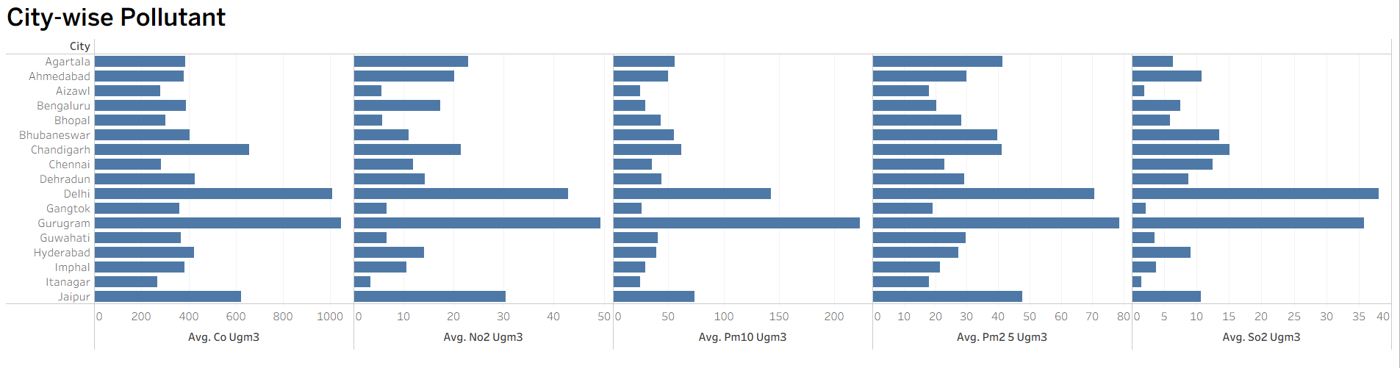
VISUALIZATION 03
Multi-Pollutant Chemical Composition
Identifying emission sources through chemical signature analysis
Traffic-Related Markers
NO₂ (Nitrogen Dioxide)
PRIMARY
Direct indicator of vehicular emissions
CO (Carbon Monoxide)
SECONDARY
Incomplete fuel combustion marker
PM₂.₅ & PM₁₀
MIXED
Both traffic & industrial sources
Industrial Markers
SO₂ (Sulfur Dioxide)
INDUSTRIAL
Coal combustion & industrial processes
Chemical fingerprinting enables source apportionment for targeted mitigation strategies

Slide 11
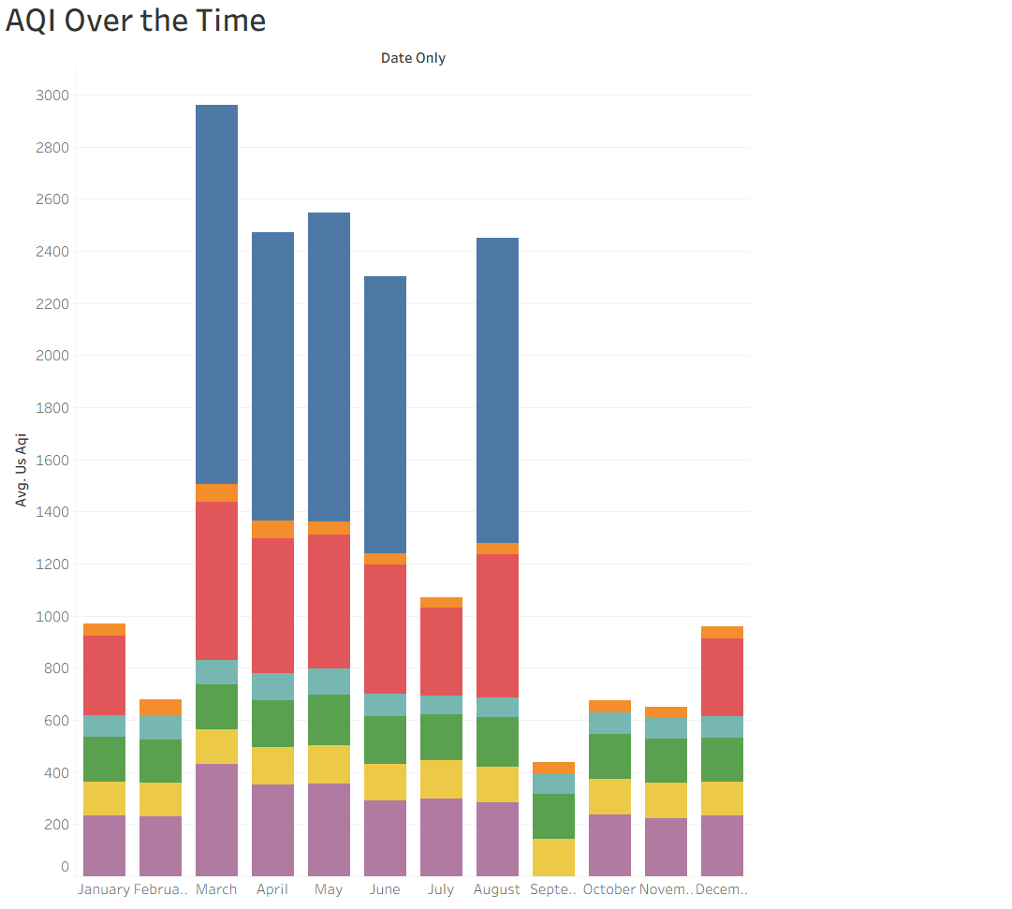
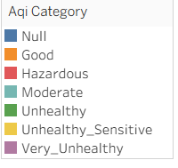
VISUALIZATION 04
Temporal Trends: Seasonal & Monthly Patterns
Timeline analysis for predictive air quality management
Seasonal Patterns
Winter (Nov-Feb)
HIGH RISK
PM₂.₅/PM₁₀ peaks due to inversion & heating
Summer (Mar-Jun)
MODERATE
Better dispersion, but dust storms increase PM
Monsoon (Jul-Oct)
LOW RISK
Rainfall washes out particulates
Diurnal Patterns
Morning peak (8-10 AM): Rush hour
Evening peak (5-8 PM): Return traffic
Mid-day lull: Lowest pollution levels
Predictive capability: Identify high-risk periods for early public health warnings

Slide 12
KEY FINDINGS
Conclusion & Policy Recommendations
Transforming data insights into actionable urban policy
Key Insight
Policy Recommendations
Traffic congestion is the primary driver for PM₂.₅ and NO₂ spikes, directly correlating with "Unhealthy" AQI categories across monitored urban areas.
Low Emission Zones (LEZ)
01
Restrict high-emission vehicles in city centers during peak hours
PM₂.₅ Increase
NO₂ Increase
40-60%
50-70%
Synchronized Traffic Signals
02
Implement smart traffic management to reduce idling time
Active Mobility
EV Incentives
Early Warning
Promote cycling & walking infrastructure
Accelerate electric vehicle adoption
Real-time public health alerts
"Data visualization bridges the gap between complex environmental science and effective public policy , enabling evidence-based decision making for healthier cities."

Slide 13

Data-Driven
Environmental Action
Transforming complex sensor data into actionable insights for healthier, more sustainable cities
10,000+
Multi-City
Actionable
Data Points Analyzed
Urban Coverage
Policy Insights
Thank you for your attention

